Slide 1
Connecting Instrument Response to Atmospheric Concentrations for Unknown Organics: Steps forward in investigating secondary aerosol formation processes
Emily Barnes, IEOR 242 Final Project

Slide 2
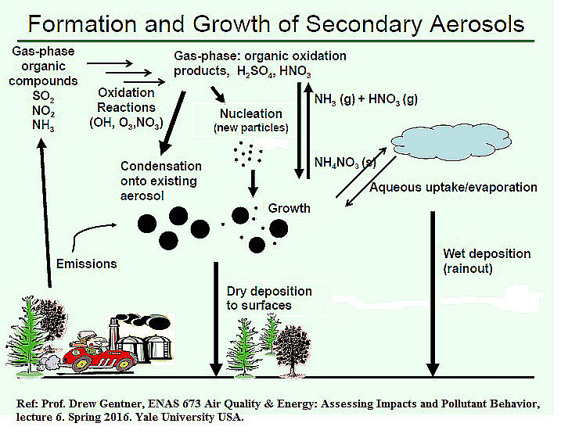
Background: Secondary Organic Aerosol
Aerosol= Airborne Particulate Matter
Aerosols are important because they impact climate (clouds, direct light reflection) and human health
Secondary Aerosol = Aerosol formed in the atmosphere from oxidation of gasses (emitted by biosphere and human activities)
Secondary Organic Aerosol dominant among small, longlived particles
Victor Moriyama / Greenpeace / via AFP - Getty Images
Notes:
So to give some quick background, my research focuses on aerosols, and specifically

Slide 3
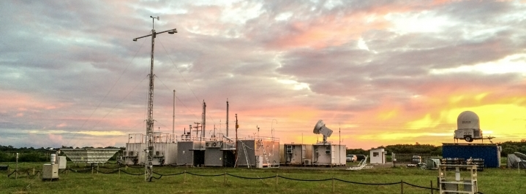
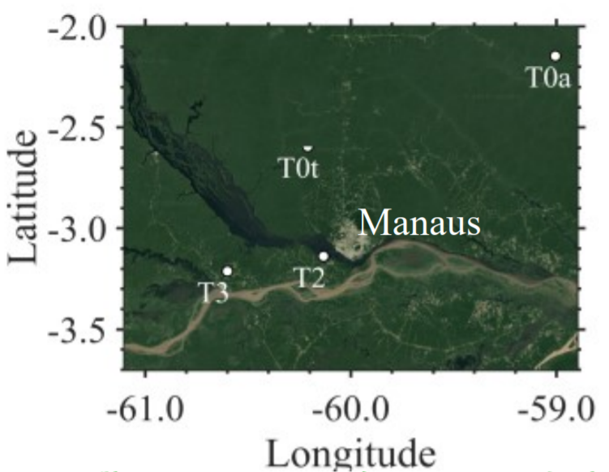
Data: GoAmazon Field Campaign 2014/15
Field site in a remote location in central Amazonia, occasionally impacted by slash/burn and urban activity (Manaus 70 km distant)
2 intensive operating periods (wet season January-March, dry season August-October)
Aerosols continuously collected on filters (4-12 hour resolution)
US Dept of Energy
De Sa, ACP, (2018)
Notes:
My data originates from the

Slide 4
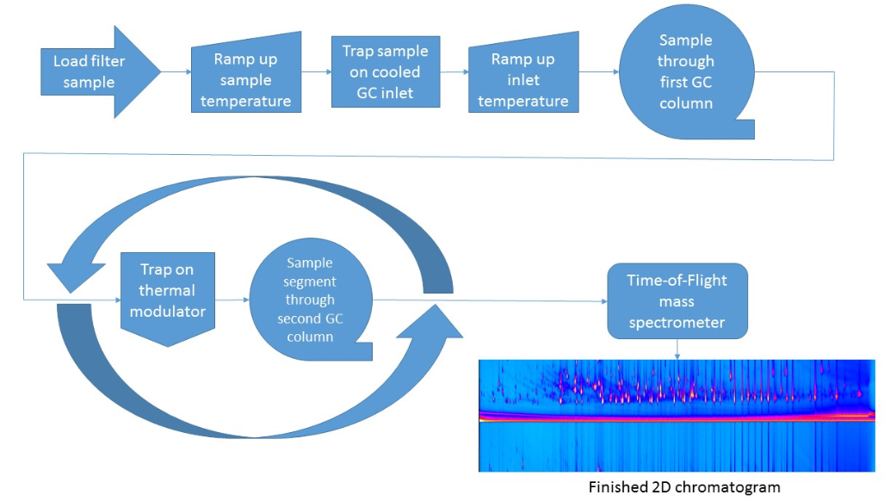
Data: GCxGC-TD-EI/VUV-HR-ToF-MS
GC = Gas Chromatograph
TD = Thermal Desorption
EI = Electron Ionization
VUV = Vacuum Ultra-Violet
HR = High Resolution
ToF-MS = Time of Flight Mass Spec
Notes:
Over the past year I have analyzed these filters using a 2d GC, an instrument which evaporates the aerosol components off of the filters separates them using two gas chromatography columns, and sends the separated compounds to a mass spec

Slide 5
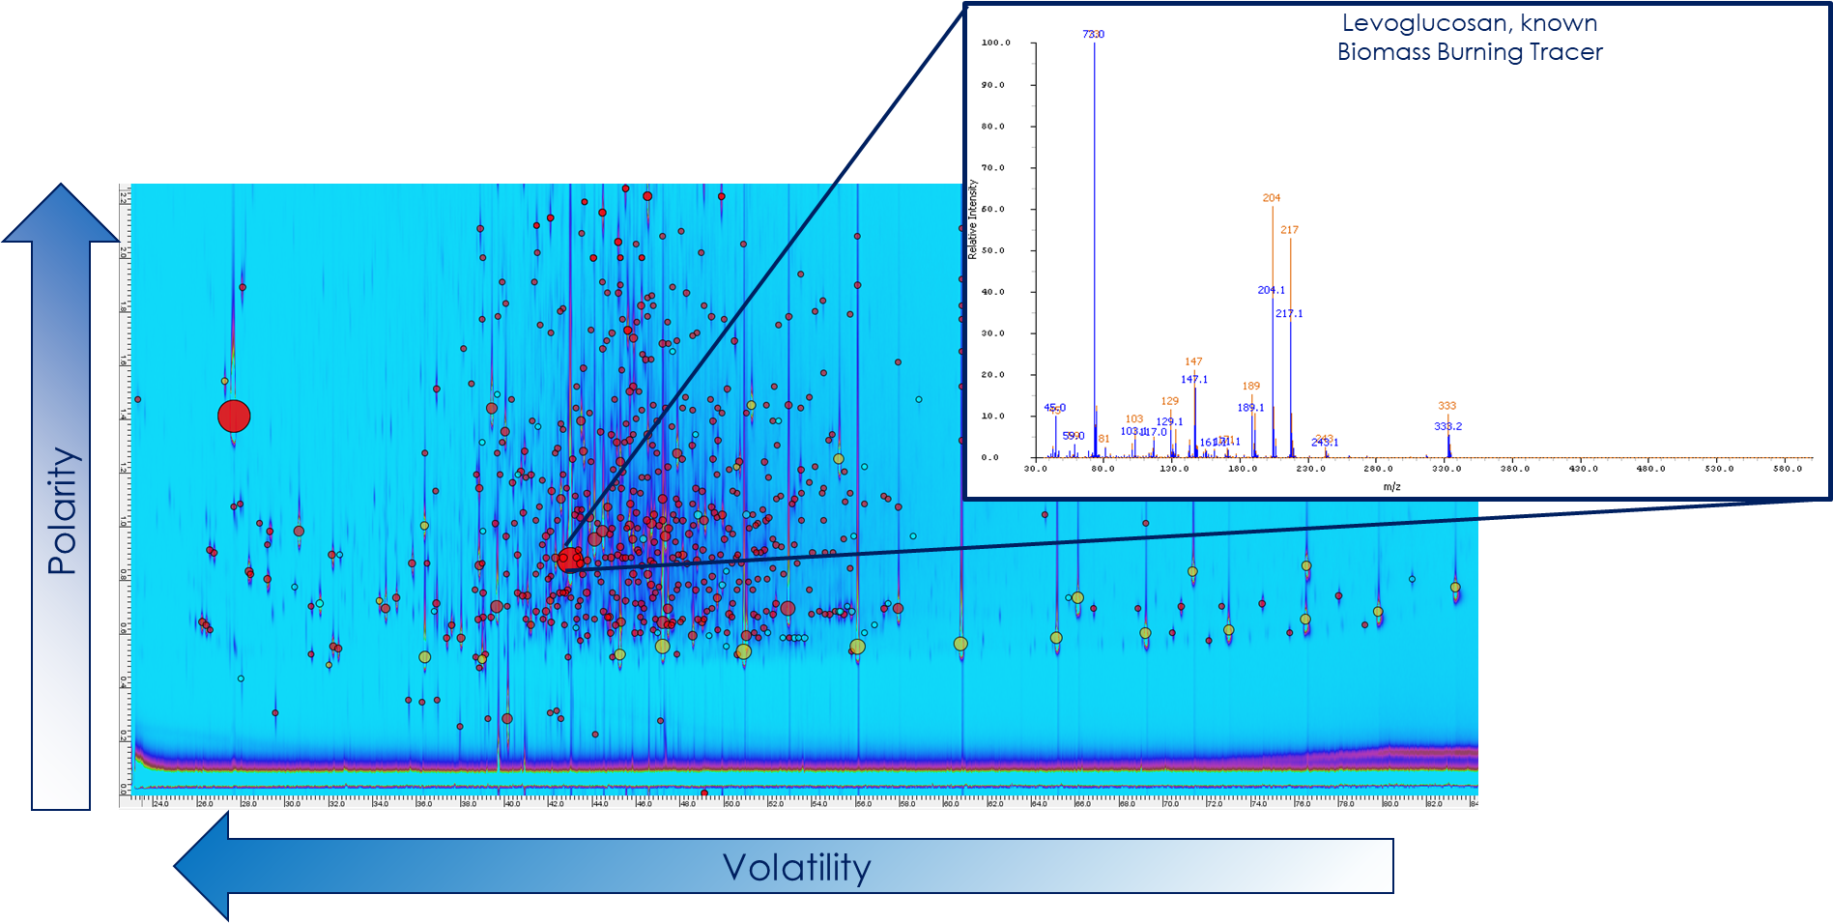
Data: GCxGC-TD-EI/VUV-HR-ToF-MS
Notes:
This results in a 2D image in which each compound has a discrete location in volatility/polarity space and a mass spectral fingerprint unique to that particular compound. I have ~130 of these images forming a time series of each of the two intensive operating periods.

Slide 6
Motivation/Challenge: Quantification of Unknown Compounds
~2000 unique compounds identified and traced throughout campaign, >80% of these cannot be definitively identified (no authentic standards or published mass spectra exist)
Different compound classes exhibit different response factors (mass compound in(ng): instrument response (volume))- over order of magnitude differences observed
How can unidentifiable compounds be quantified?
Notes:
Each of these images is itself a rich dataset, and considering >100 of them as a time series poses many challenges. The most significant of these is that I have identified ~2000 compounds to trace

Slide 7
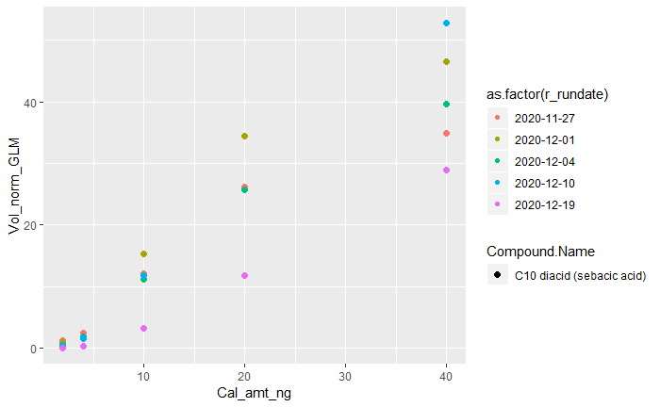
Data Source: External Standard
135 known compounds run on instrument at 5 levels (above 0) to form 6 point calibration curve
5 calibration curves run throughout filter processing period (instrument response changes over time and with maintenance)
Goal: given compound location (volatility index, polarity index), run date, and mass spectrum (all the info we have on the 2000 unknown compounds), predict the instrument response factor
Calibration Curve Example: Sebacic Acid
Normalized Instrument Response (Volume)
Calibration Amount Injected (ng)
Notes:
For known compounds the accepted best practice for quantification is the use of calibration curves, in which different levels of a known the compound are injected into the instrument to establish the instrument response factor for that compound. I performed 6 point calibration curves for 135 compounds 5 times during the filter processing period. My goal is to use the external standard to develop a model which can be applied to the unknown compounds to establish calibration factors for each. Here we have an example of the cal curves for sebacic acid.

Slide 8
Analytical Models: Directly Predicting Mass*
*Treat each point of each cal curve as a data point, predict mass injected into instrument given response volume, location, date, and mass spec
Model | OSRsquared | MAE
Linear Model: First Pass | .22 | 14.2
Linear Model: Co-Varying factors removed | .23 | 14.1
CART | .66 | 7.76
Random Forest: | .81 | 5.68
Boosted: | .83 | 5.62
Notes:
My first approach involved directly modeling injected mass based on instrument response volume. Although the volume/mass relationship is very linear as I just showed in the sebacic acid cal curve, the linear models performed very poorly. CART was somewhat better, and RF and Boosted are similarly quite good.

Slide 9
Analytical Models: Directly Predicting Mass
Model | OSRsquared | MAE
Linear Model: First Pass | .22 | 14.2
Linear Model: Co-Varying factors removed | .23 | 14.1
CART | .66 | 7.76
Random Forest: | .81 | 5.68
Boosted: | .83 | 5.62
Problem: External standard injected at discreet levels, does not represent entire continuum of atmospheric levels we expect to observe.
Solution: model the Ratio (ng to instrument volume) instead.
Notes:
However, the problem with this approach is that all of the cal curves consisted of injecting the standard at the same discreet levels which does not represent the entire continuum of atmospheric levels I expect to observe. My solution to this problem is to model the slope of this relationship instead.

Slide 10
Analytical Models: Predicting Slope*
*Treat each entire cal curve as a data point, predict mass:volume ratio (slope) given the date, location, and mass spec
Model | OSRsquared | MAE
CART | -1.3 | 14.4
Random Forest (low mtry) | .81 | 11.0
Random Forest (cross validated) | .42 | 11.1
Boosted: | .35 | 15.6
Notes:
Model performance on slope modeling is remarkably worse, possibly because the dataset is a factor of 5 smaller. The CART model performance is just abysmal, and random forest and boosted are similarly not great. While one iteration of random forest with a lower mtry value has a remarkably better OSR2, the MAE is not improved indicating that there are still problems.

Slide 11
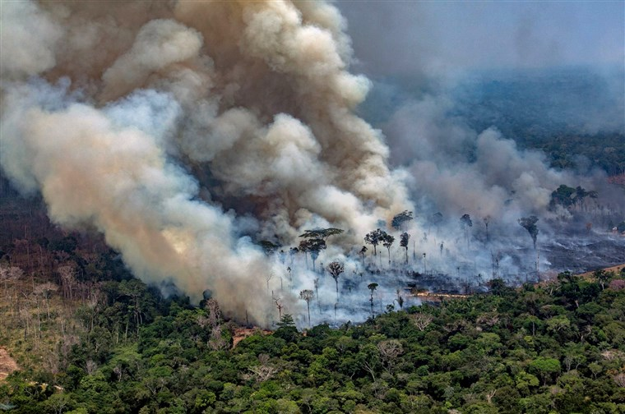
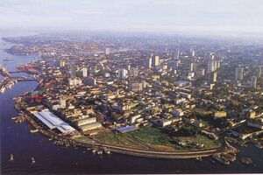
Impact
Quantification of individual compounds -> identification of sources and transformation pathways leading to the formation of airborne particulate matter
Unravel the mystery of order of magnitude increase in ‘dry season’ aerosol levels in the Amazon
Probe human influences on aerosol formation (through cities and fires) => inform climate models
Victor Moriyama / Greenpeace / via AFP - Getty Images
https://rio.fandom.com/wiki/Manaus
Notes:
There is still more work to be done, but…

